Slide 1
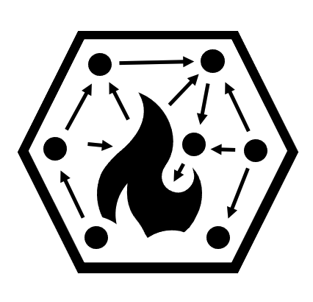
A Grammar of Coordination and Collaboration in Wildfire Risk Management
Cody Evers, Portland State University
AAG 2021 - “Seattle”
April 10th, 2021

Slide 2
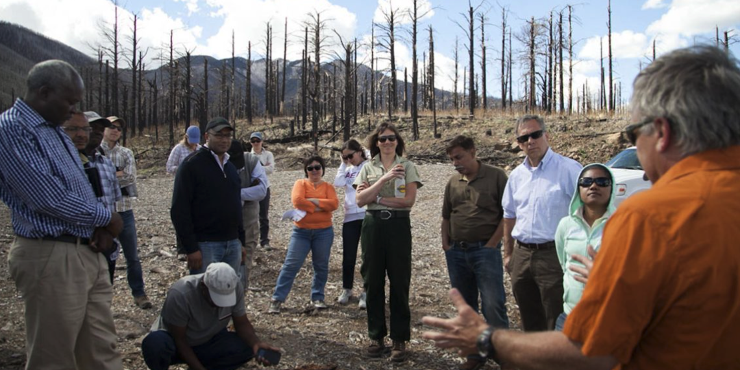
Increased trends towards collaboration in wildfire
Examples include
Community Wildfire Protection Plans
Forest Collaborative
Cohesive Strategy
Collaborative Forest Landscape Restoration Projects
Shared Stewardship
USFS NRCS Joint-Chiefs Program
Due to shifts in governance
Network governance
Decentralized capacity
Expanding management goals
Landscape planning/perspective
Due to shifts in fire behavior
Larger, more intense fires
Greater contiguity of fuels
Expanding wildland urban interface
Complex operating environment

Slide 3
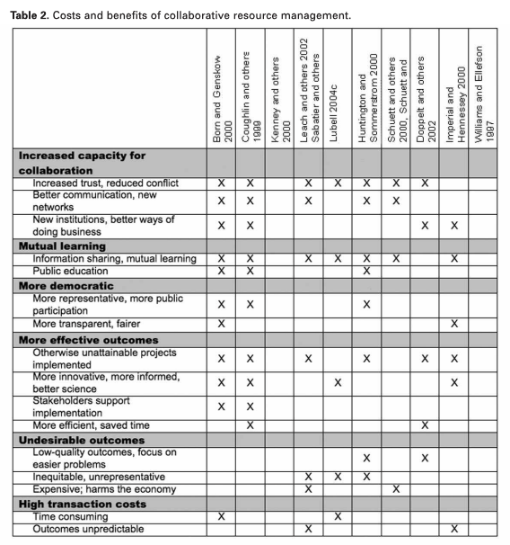
Benefits and costs of collaboration
Benefits of collaboration include...
Increased trust, reduced conflict
Mutual learning
Decreased externalities
Greater representation & transparency
New institutional arrangements
BUT additional costs and risks too...
transaction costs, opportunity costs
disagreement on course of action
disagreement division of costs
others may renege or free ride
Moote & Lowe (2008) What to Expect from Collaboration in Natural Resource Management

Slide 4
Need for a refined grammar
Divergent view
Linear view
Coordination
Medium trust
Structured communication flows
Semi-independent goals
Power remains within organizations
Shared resources around projects
Cooperation
Cooperation
Coordination
Collaboration
High trust, stable relations
Thick communication flows
Interdependent goals
Shared power
Pooled resourced
Collaboration
Notes:
Coordination occurs when there is a need to better align or ‘orchestate’ people, tasks and systems to achieve a predetermined goal or mission.
Collaborating occurs when there is a need for developing new systems and/or institutional arrangements to get tasks accomplished.
Coordination places emphasis on bringing together interdependent parts into an ordered relationship to produce a whole. Coordination is not dependent on the good will of the different actors, but has some force of an objective, a mandate, leading to a more enduring and formalised system of relationships
Collaboration characterized by high levels of interdependence, dense relationships, and an understanding that actors cannot meet their interests working alone and that they share with others a common problem. Although all forms of working together require some degree of interdependence, collaborations require reciprocal interdependence.

Slide 5
Contrasting coordination vs collaboration (structural view)
Burt’s brokerage and closure as opposing network forces
Individual social advantage results from bridging network holes, and to a less extent the amount of network closure.
Group social advantage linked to both internal cohesion and non-redundant bridges to external groups

Slide 6
Structural definitions of coordination and collaboration
Ego node Group A Group B
*
*
*
*
*
*
*
Coordination
Open, bridging structure; Mission alignment (reflected by affiliation)
Collaboration
Closed, bonding structure; Mission diversity (reflected by affiliation)

Slide 7
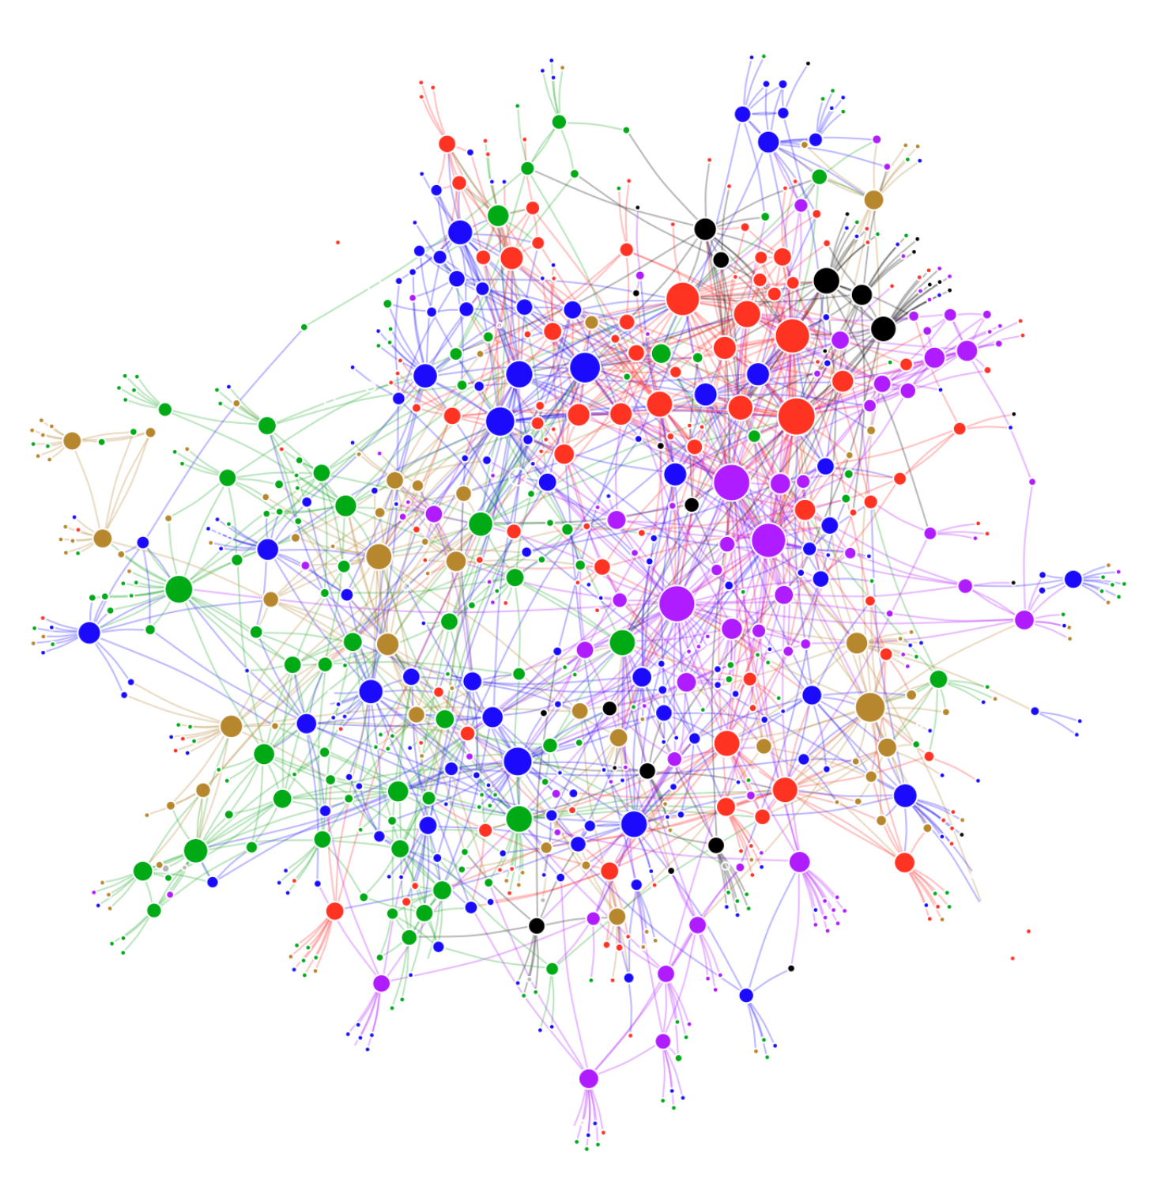
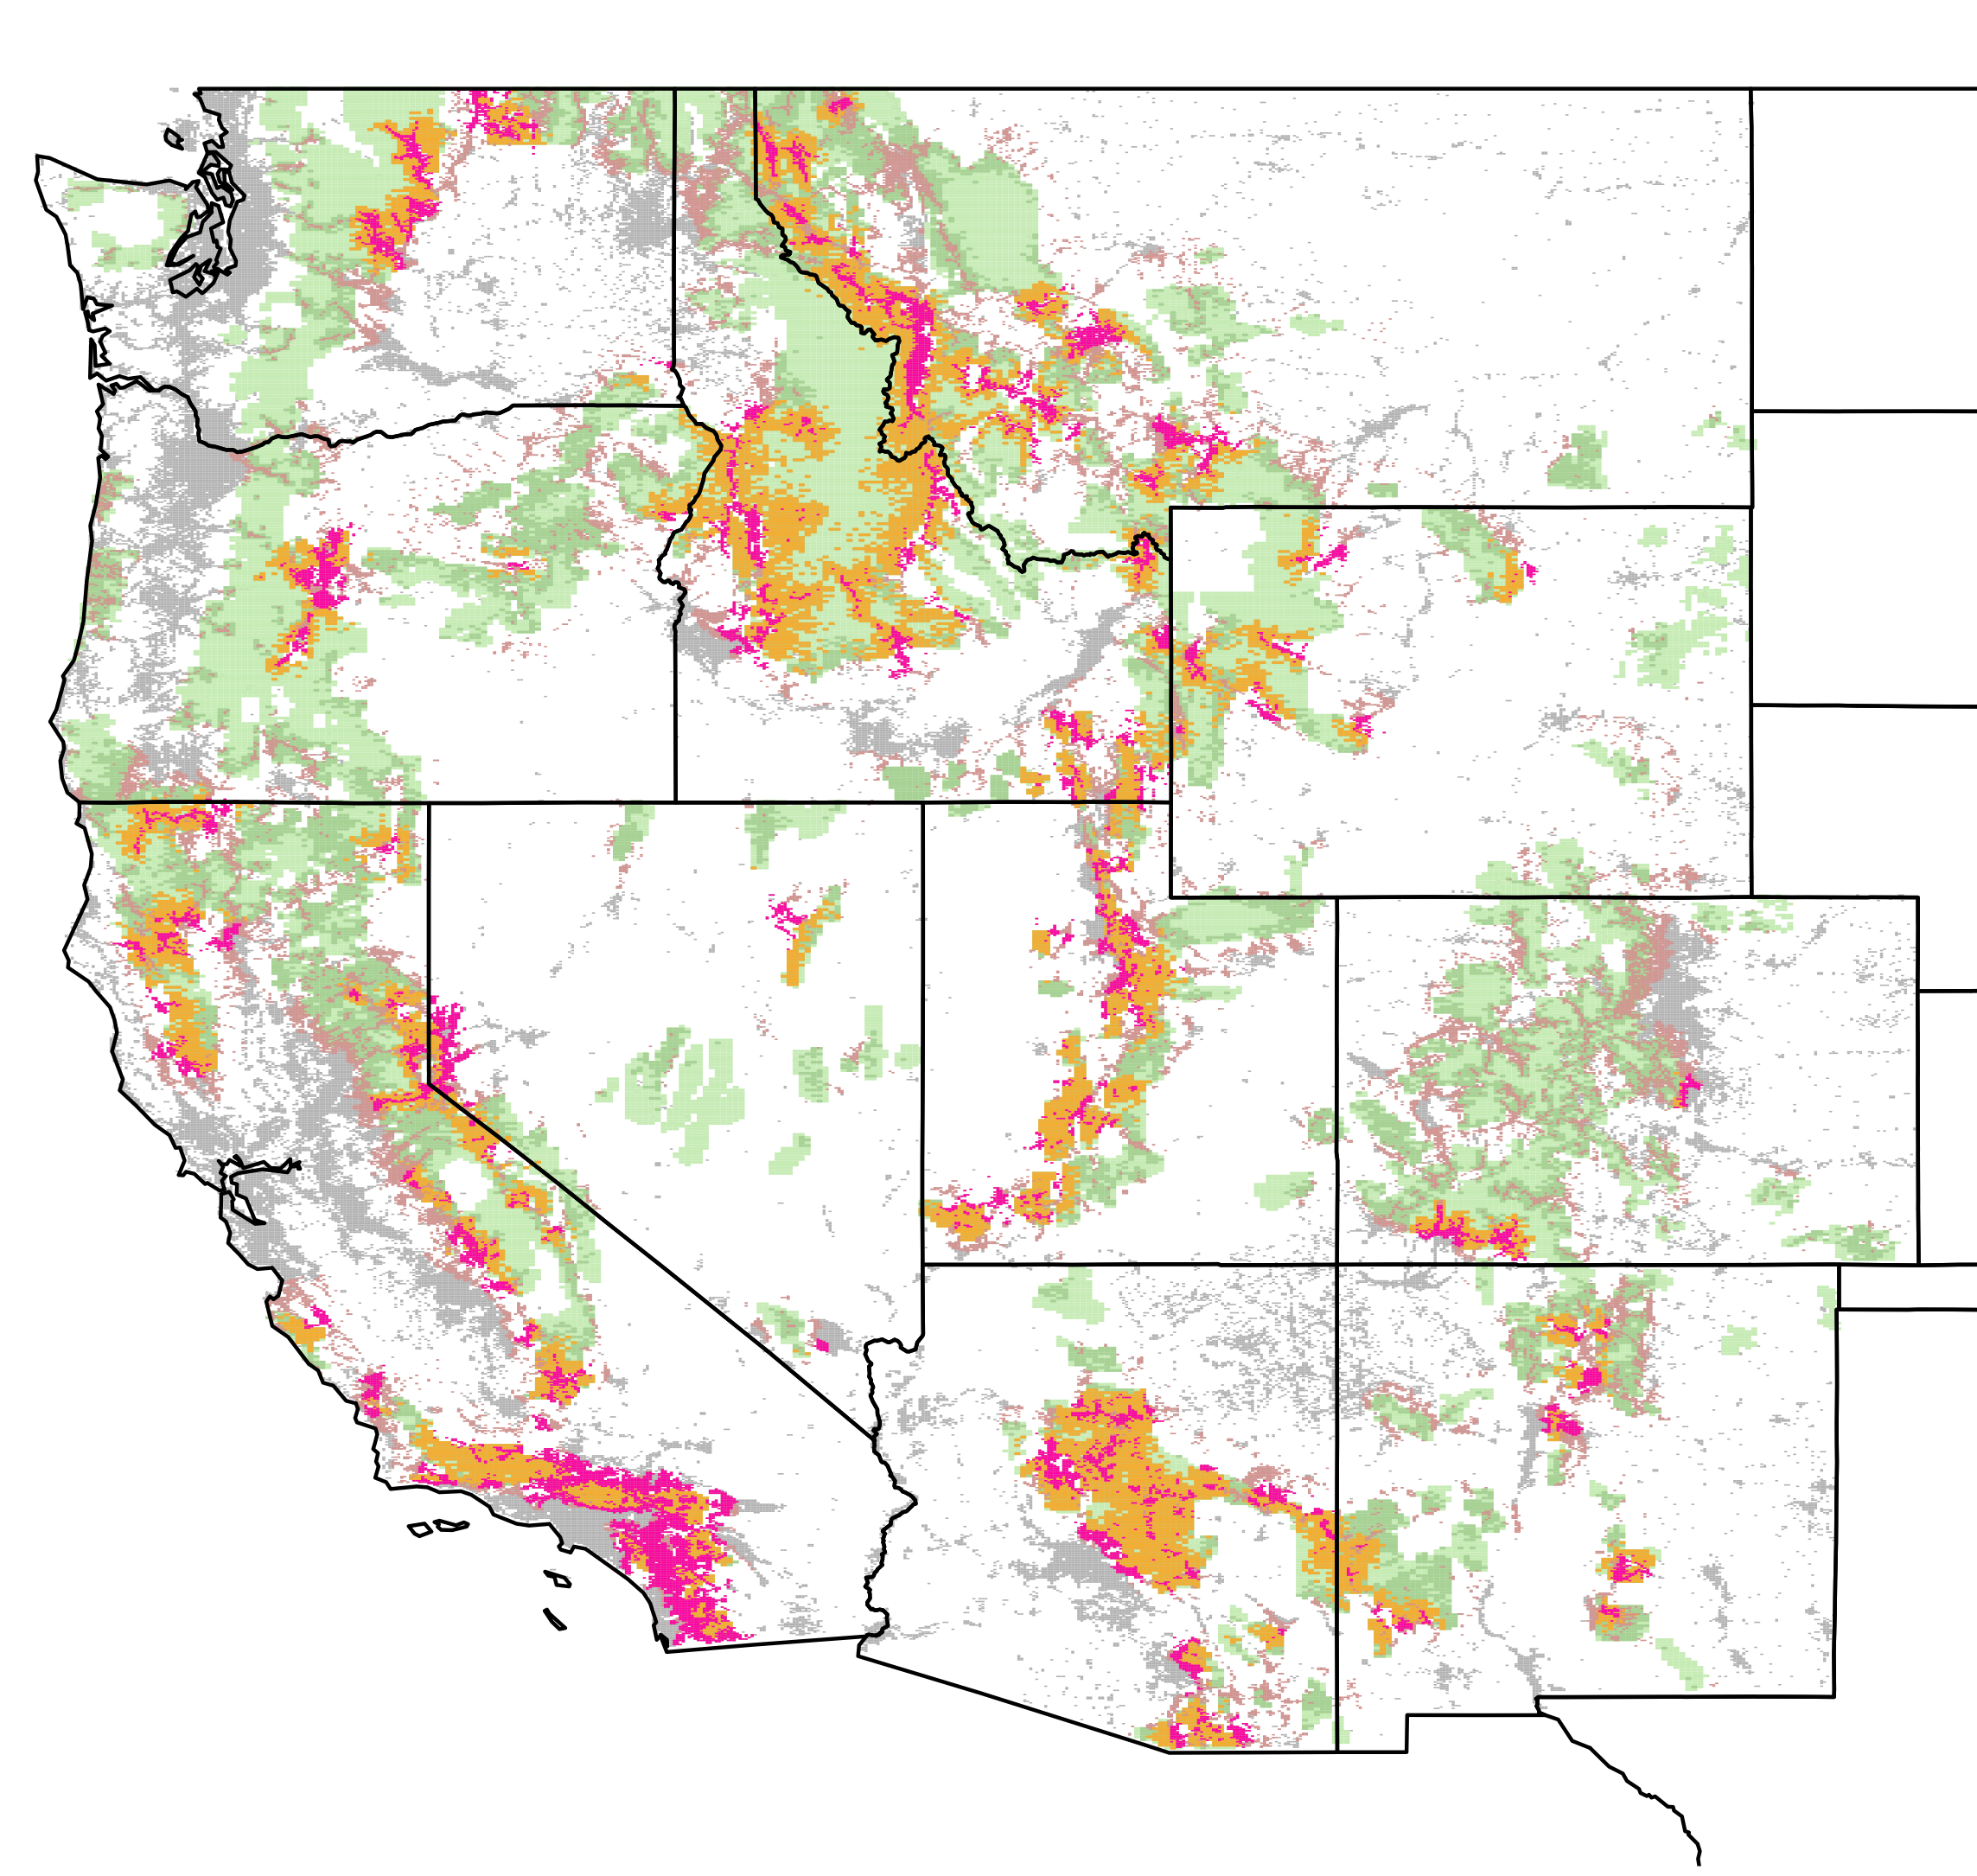
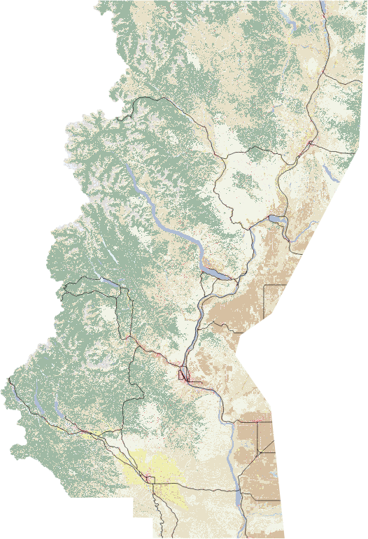
Wildfire risk management networks in the Western US
North Central Washington
1
2
3
4
6
8
5
7
10
Methow
9
11
14
Chelan
12
16
15
17
Leavenworth
13
18
Wenatchee
19
20
21
23
24
22
Yakima
Do different types of organizations pursue different collaboration and coordination strategies?
USFS | Federal | State | NGO | Local

Slide 8
Null network model (permutation test)
Coordination
*
*
*
*
*
*
Collaboration
USFS | + | . | -- | . | -- | --
Federal | + | . | -- | + | . | --
State | + | . | . | . | -- | .
NGO | + | + | . | + | + | .
Local | + | + | . | + | + | .
more common than expected (sought)
less common than expected (avoided)

Slide 9
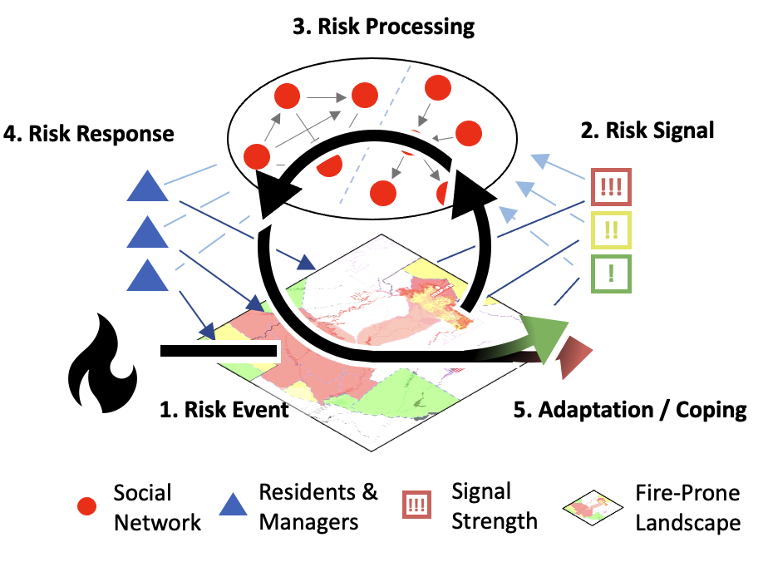
Coordination & collaboration in socio-ecological systems
Social influence network
Coordination and Collaboration as network behavior:
Collaboration: decreased contestation Coordination: increased signal strength
Coordination and Collaboration as outcomes:
Coordination = coping; efficiency gains
Collaboration = adaptation; system change

Slide 10
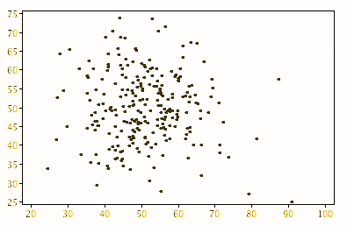
ENVISION SNIP risk processing model
LANDSCAPE SIGNAL → → → INFLUENCE NETWORK → → → LANDSCAPE RESPONSE
response i
Signal Strength
Landscape
Signal
Network Actors
Landscape Actors
Signal Contestedness
INPUTS:
Landscape Signal
(Strength & Polarity)
Network Structure
(Topology & Composition)
OUTPUTS:
Signal Contestedness & Signal Strength

Slide 11
Q?
End
Cody Evers
cevers@pdx.edu
www.codyevers.com

Slide 12
Appendix A: Overview of Envision
SNIP Social Network Influence Model

